Slide 1
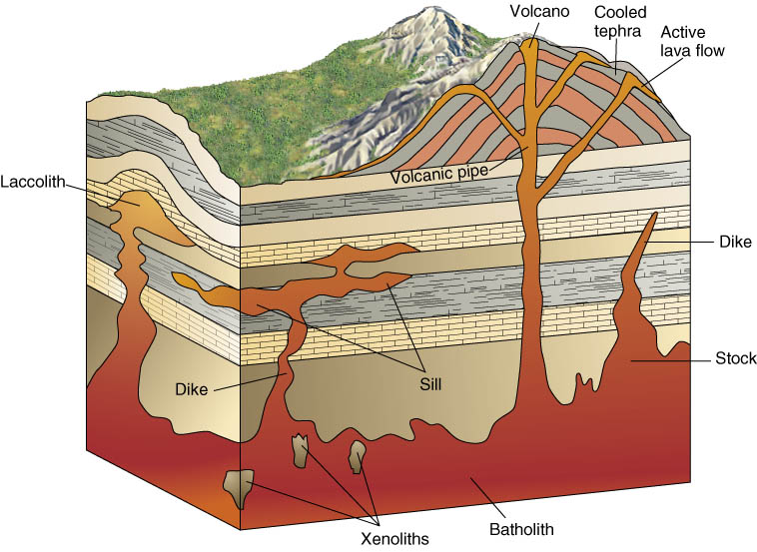
Igneous Rocks & Volcanoes

Slide 2
Lab Format & Objectives
Part I:
Identify 10 Igneous Rocks (60 min)
Part II:
Construct specialty hazard map for Hawaii
Construct 2nd hazard map with all specialty data
Write letter to Hawaii emphasizing where best to build/not to build based on hazards

Slide 3
4 Items to Turn In
Part I: Igneous Rocks Identification
Definitions (Describing texture)
Igneous Rocks Chart
Part II: Natural Hazards of Hawaii
Hazard Specialties Map (Preliminary hazards specialty map)
Hazards Assessment Map (Final hazards zone map with Hazard Assessment recommendation)

Slide 4
Part I
Identification of Igneous Rocks
Intrusive vs Extrusive: Slow vs Fast Cooling
What about color: Mafic vs Felsic

Slide 5
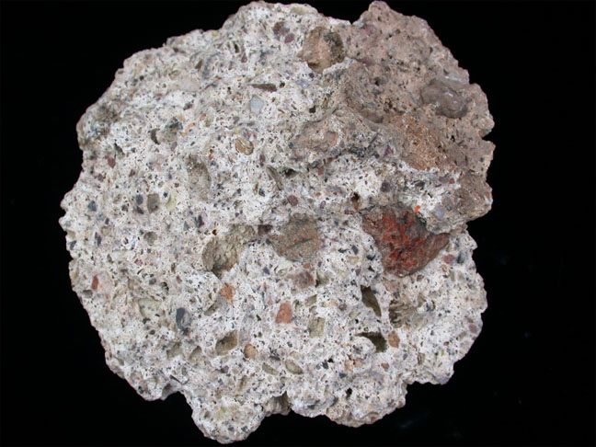
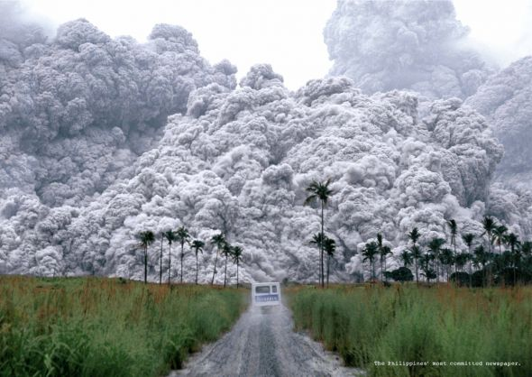
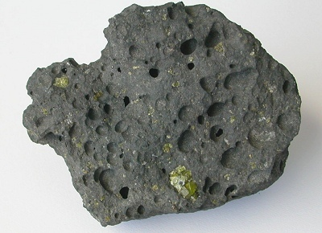
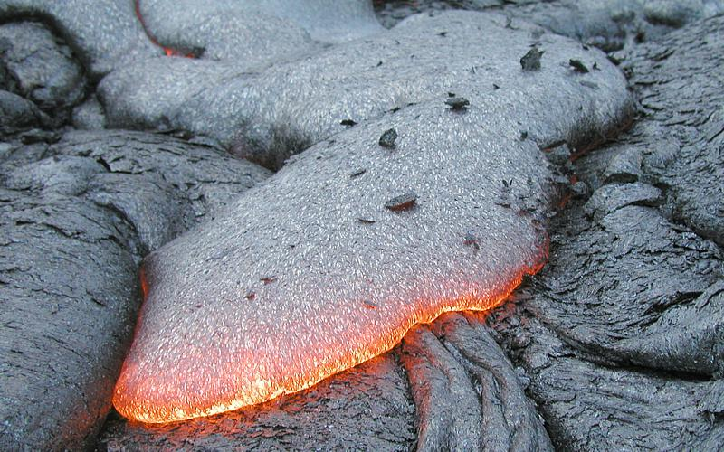
Igneous Rocks can help determine volcanic history and hazard potential…

Slide 6
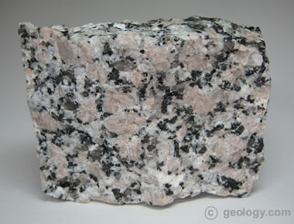
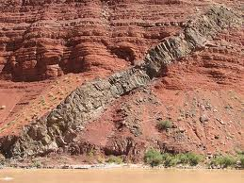
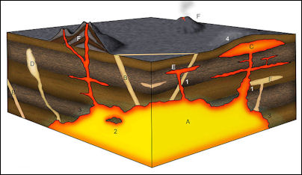

Slide 7
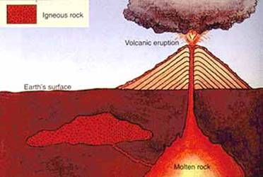
What Igneous Rocks do we have today and where did they come from?
Let’s start with Intrusive vs. Extrusive:
Intrusive igneous rocks: form when magma cools inside earth’s crust (beneath ground). Plutonic
Extrusive igneous rocks: form when magma cools above earth’s crust (above ground). Volcanic.

Slide 8
Intrusive vs. Extrusive
Intrusive; slower cooling = larger crystals
Extrusive; faster cooling = smaller crystals
Find an intrusive and extrusive rock in you box and be prepared to show it to me…

Slide 9
Extrusive Rocks – Pyroclastic Rocks
Pyroclastic rocks: transitional between igneous and sedimentary
Tuff

Slide 10
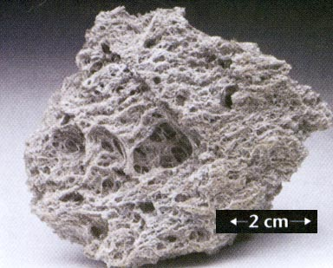
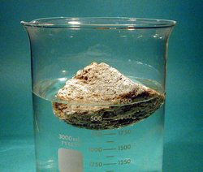
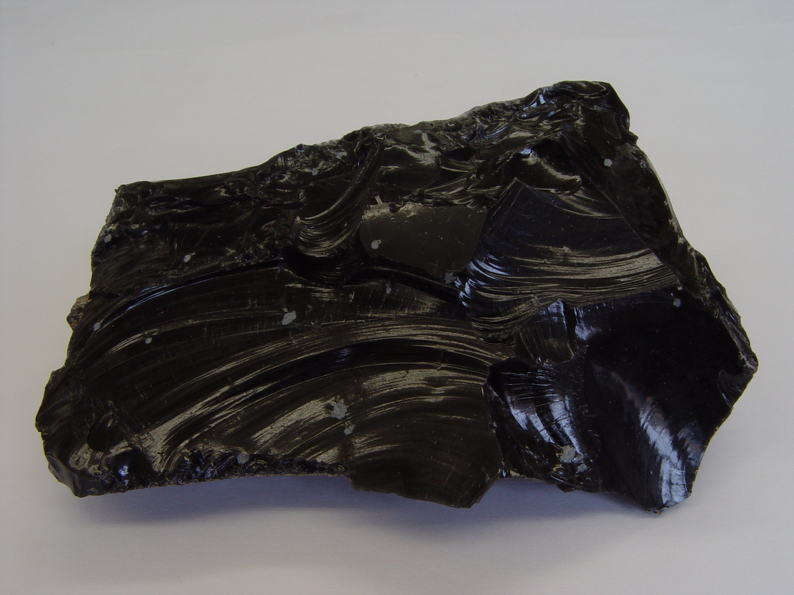
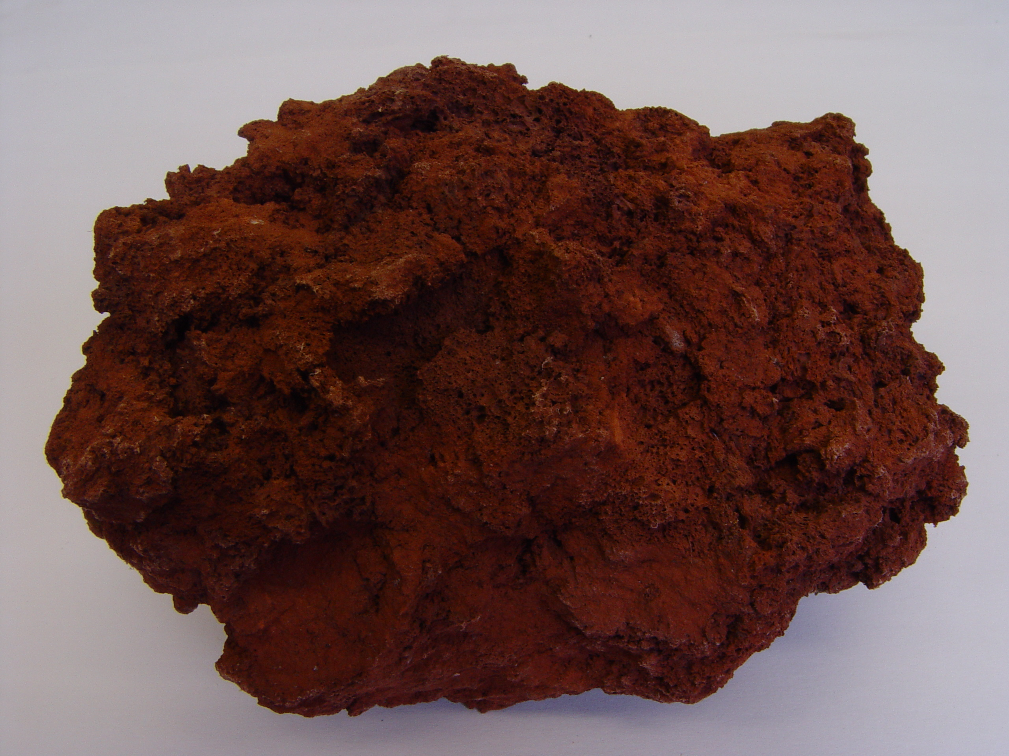
Extrusive Rocks – Glassy & Vesicular
Pumice
Basalt
Scoria
Obsidian

Slide 11
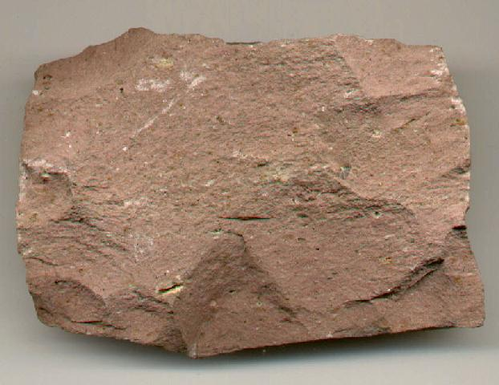
Extrusive Rocks – Aphanitic
Crystals can’t be seen with hand lens
Basalt
Rhyolite

Slide 12
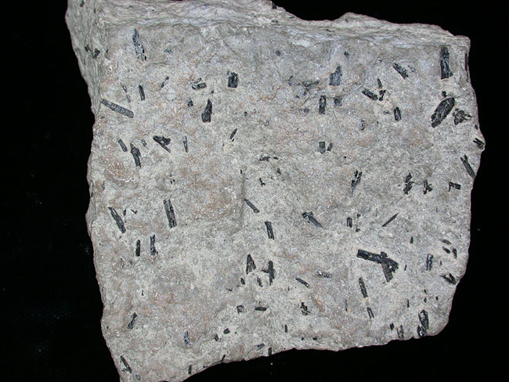
Intrusive Rocks
Phaneritic – crystals can be seen with hand lens (1-10 mm)
Pegmatitic – most crystals >1mm
Porphyritic – large and small crystals (endured slow and fast cooling)
Phenocrysts
Matrix

Slide 13
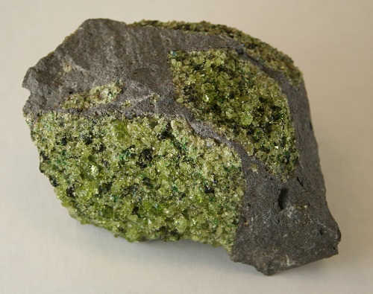
What about color?
Dark Minerals (Mafic)
Ultramafic
Light Minerals (Felsic)
>70% Mg & Fe
Mantle rock
Mg & Fe Rich
Oceanic rock
Minerals includes; Biotite, amphibole, pyroxene
Si rich
Continental rock
Minerals include; Quartz, Feldspar, Muscovite
Intermediate
Both felsic and mafic minerals

Slide 14
Mafic vs. Felsic
Mafic; High Mg & Fe = dark minerals, Intrusive
Felsic; High Si = light minerals, Extrusive
Find a mafic and felsic rock in you box and be prepared to show it to me…

Slide 15
Part II (Specialty Teams)
4 Hazard Specialty Groups; lava flows, explosive eruptions, earthquakes, tsunamis
Each group will answer corresponding observation questions found in the lab book
Each group will construct a Preliminary Hazard map for your Specialty

Slide 16
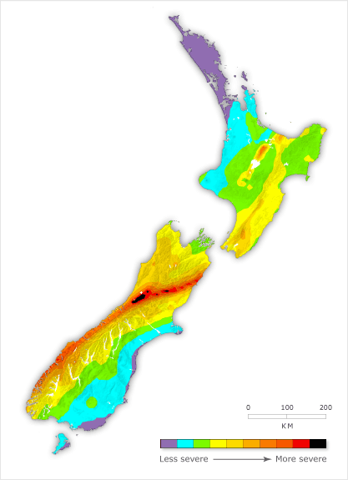
Igneous & Volcano Inquiry
Once in groups, discuss the following:
What is a hazard zone map? (think lava flows, explosive eruptions, earthquakes, and tsunamis)
Who creates these maps?
How are these maps decided upon?

Slide 17
Part II continued (Assessment Teams)
6 Hazard Assessment Teams with each team having at least one of each Hazard Specialty
Specialists will justify their hazard maps and will construct a map that best fits all data
Specialists will write a letter to the Hawaiian Government explaining the hazards and make a recommendation for best building practices
Address letter: “To: Hawaiian Department of Land and Natural Resources”

Slide 18
Tips
There is no perfect answer to some of the observational questions – you are a scientist coming up with the best information based on the data provided
Not all maps will look the same – that is okay, just be able to explain why you made your map the way you did
Have Fun!

Slide 19
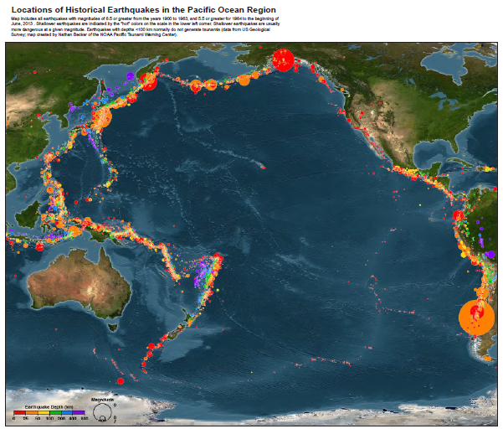

Slide 20
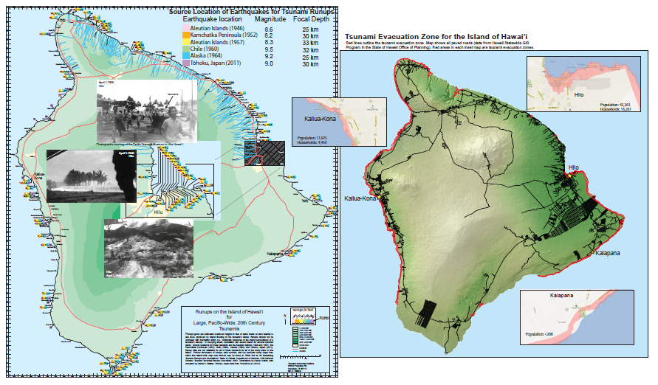

Slide 21
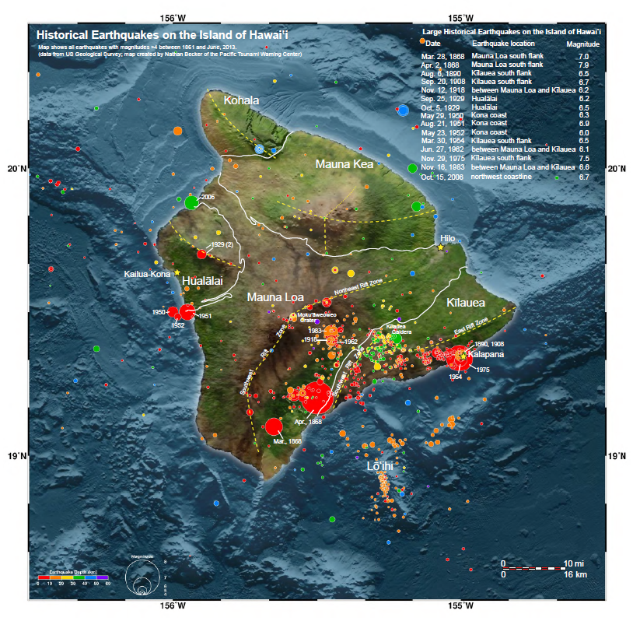

Slide 22
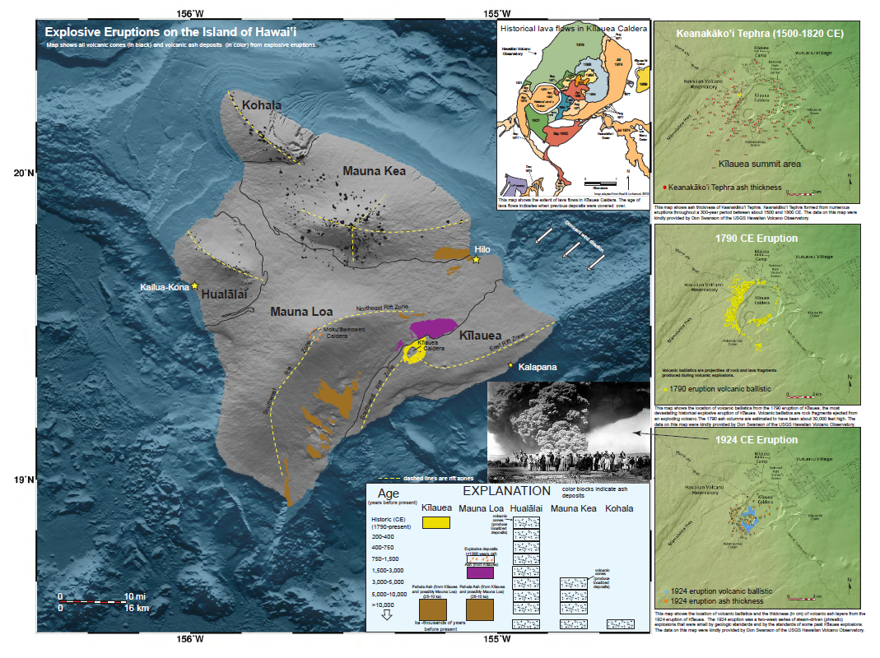

Slide 23
